Slide 1


Carpooling Made Easy
Project Information & Hi-Fi Prototype Workflow

Slide 2

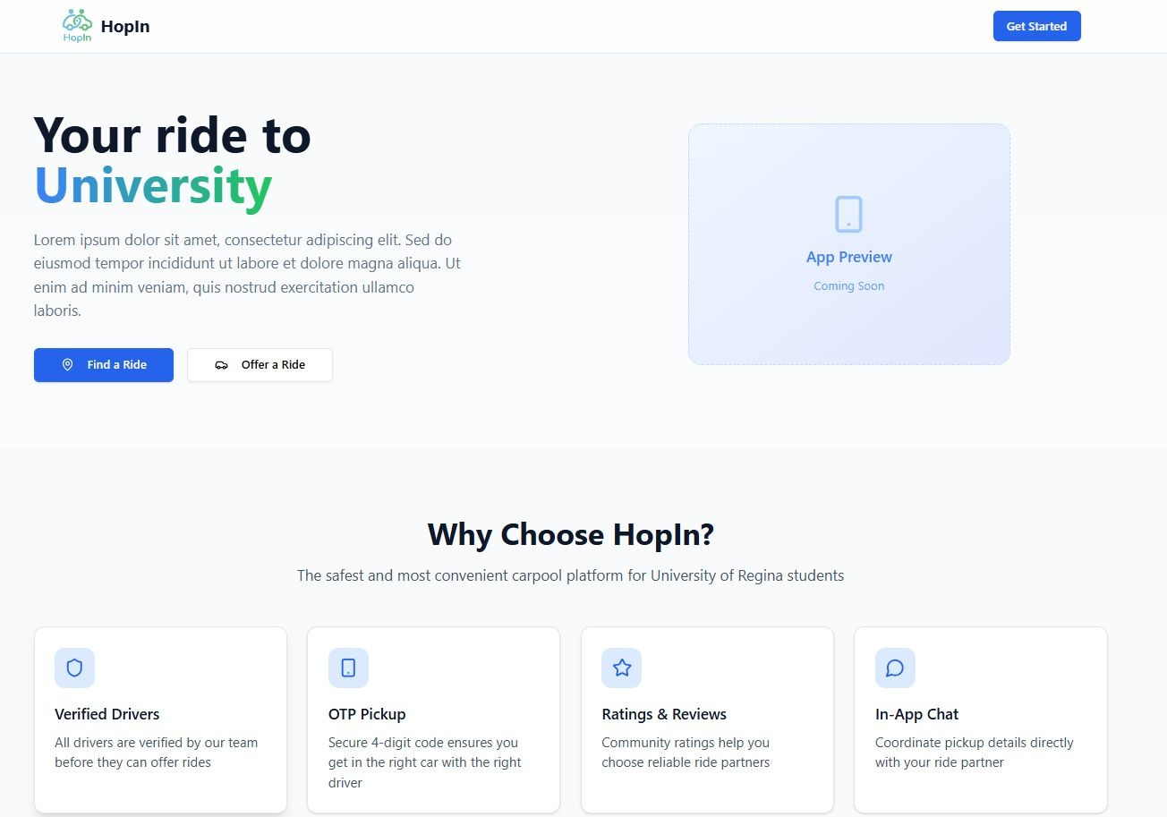
About the Project
HopIn is a platform designed to make daily commuting efficient and community-driven. By securely connecting drivers with empty seats to passengers on the exact same route, it provides a smart urban mobility solution.
•
•
•
Significantly reduces daily commuting expenses.
Lowers the carbon footprint in crowded urban areas.
Builds a trusted community through verified driver and passenger profiles.

Slide 3
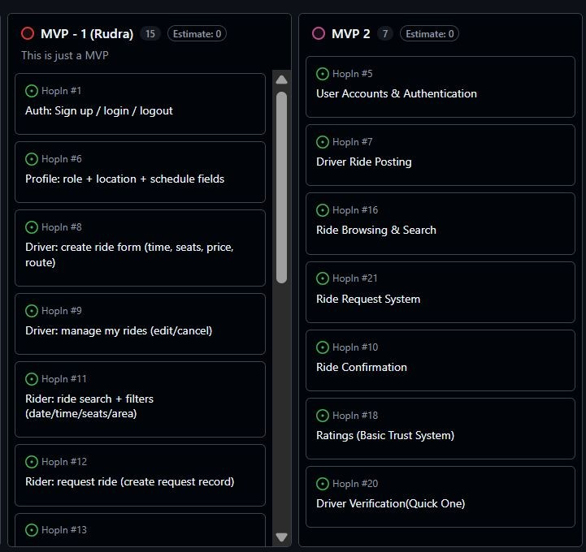
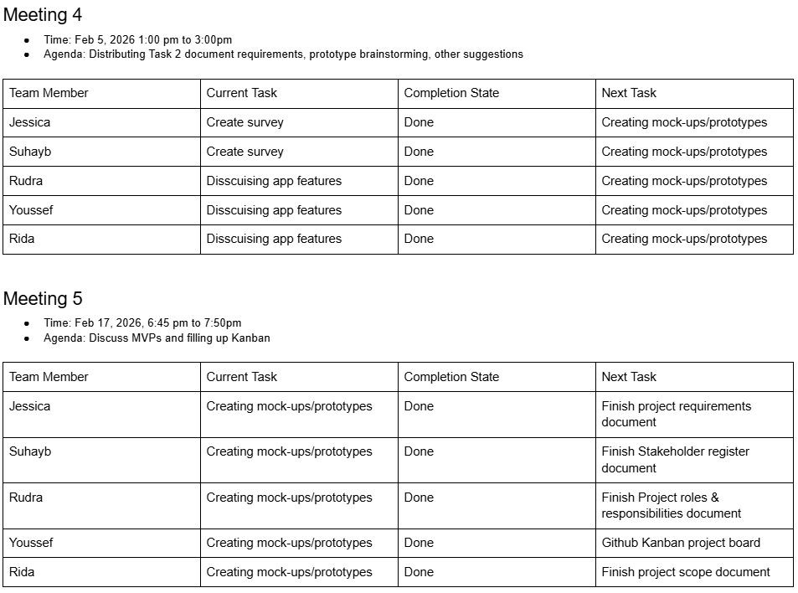
Project Planning Methods
March 4 - 21 | Page creation in HTML, css, and DB creation
March 21 - March 28 | Event handling and unit testing
March 28 - April 3 | Iteration and unit testing
1. Meeting Minutes
2. Kanban
3. Project Planning Doc

Slide 4
System Design

Slide 5
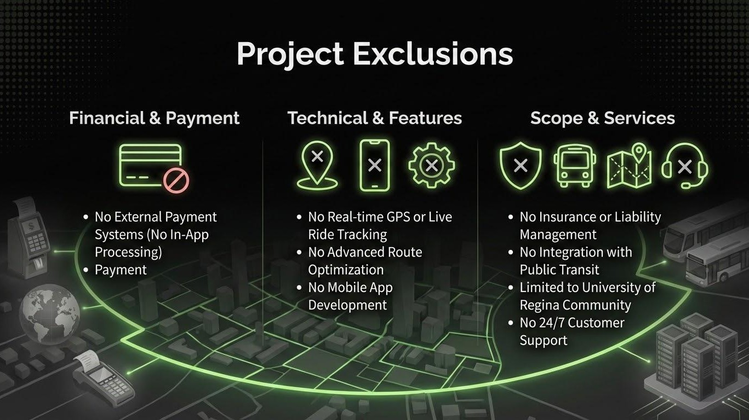

Slide 6



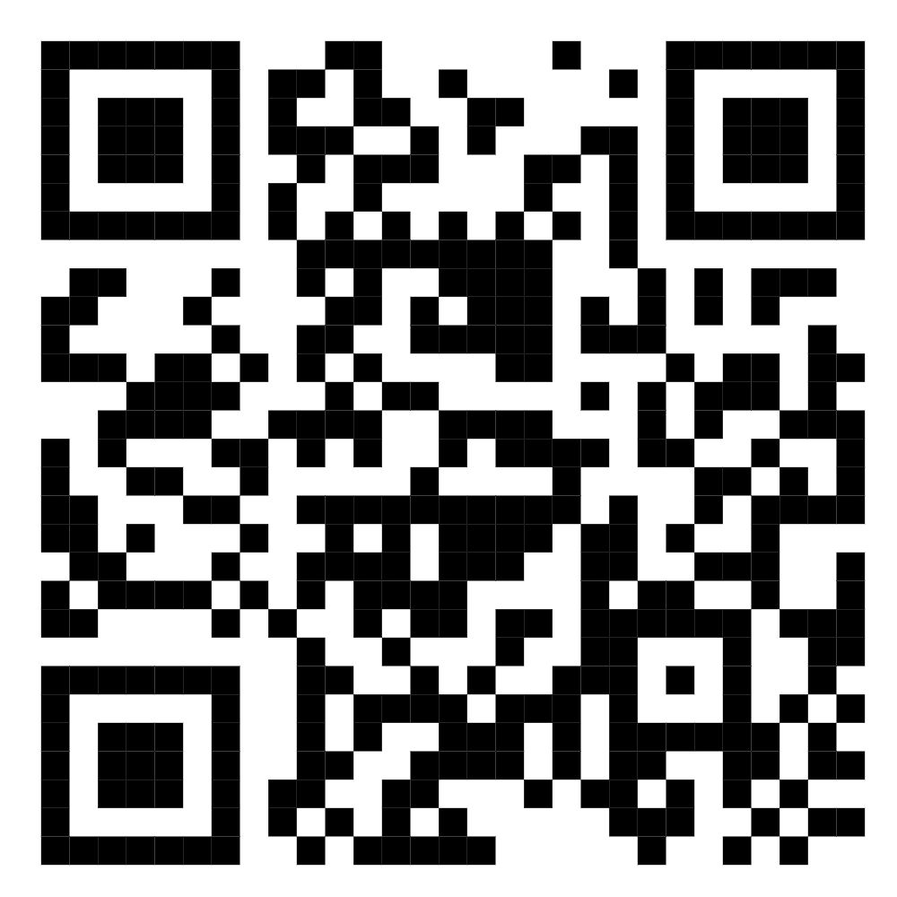
Tour + Feedback
Hi - Fi Prototype QR Code
Questionnaire QR Code

